Slide 1
In the Next Room, or The Vibrator Play
Lighting and Scenic Design
Mia Lindemann

Slide 2
Designer Concept
For scenic, the play asks for rather straightforward elements of a late 19th century home in the post Civil War era on the verge of electricity. The set is split between the two rooms, living room and operating theatre, with a half-wall-half-scrim-wall separating the rooms to provide stability for the door in the set but also to aid in visibility, so some places in the audience are not stuck with staring at a complete wall instead of the action of the scene. Being at the dawn of the electric era, the house has a moderate amount of lamps to show the eccentricity that Dr. Givings feels about the advent of this new technology.
Lighting wise, the looks will compliment the tradition image of a living room with the normalcy fluctuating upon entering the operating theatre to highlight how strange it appears to the patients treated in it. The living room part of the space will have a warm and feminine feel to it since it is regarded as Mrs. Givings’ space, where her husbands space is the operating room. The living room is lit to feed off of Mrs. Givings’ longing for her husband to see her in a less scientific and isolated way, as he has closed himself off for his science in hopes to keep his family life and work separate even while under the same roof and in the next room. The operating room, again, conversely reflects such feelings Mr. Givings emits as he interacts with the other characters; cool, mechanical, and scientific. Finally ending the play on the outside park bench, the lighting reflects how late in the evening it is as well as how close the Givings now feel, huddled together in an intimate act out in the open. The lamp post they are under acts as a spotlight in this way, providing them a small alcove of love as they act like young fools in love.

Slide 3
Research Images
Scenic

Slide 4
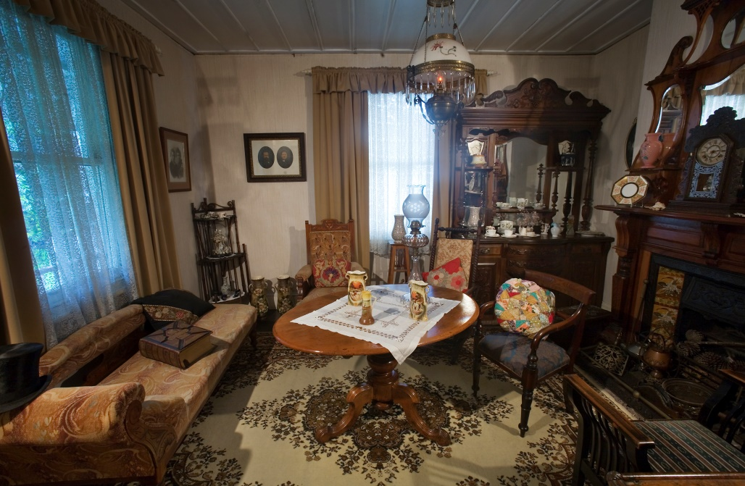
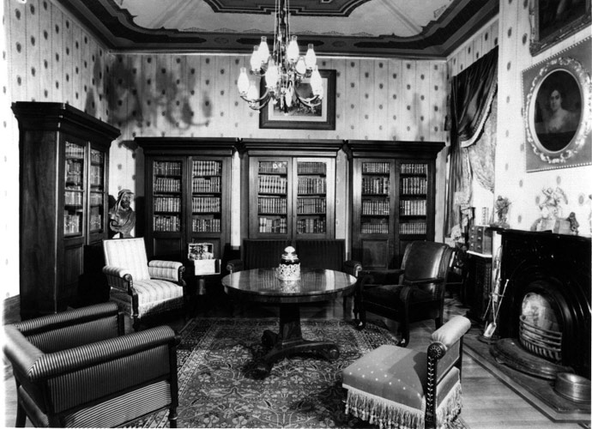
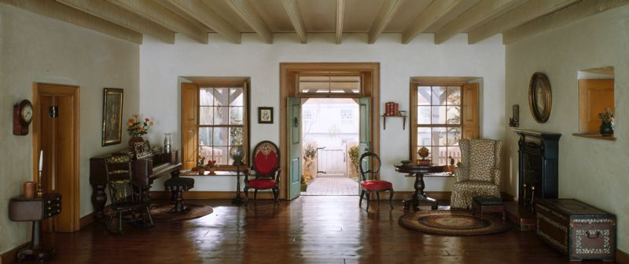
Living Room

Slide 5
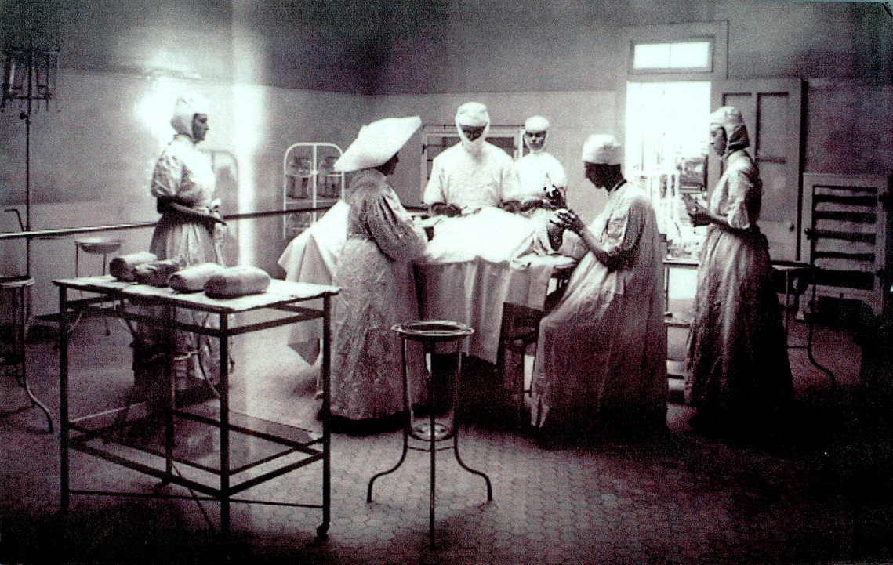
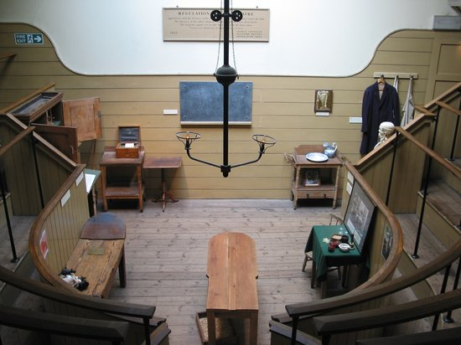
Operating Theatre

Slide 6
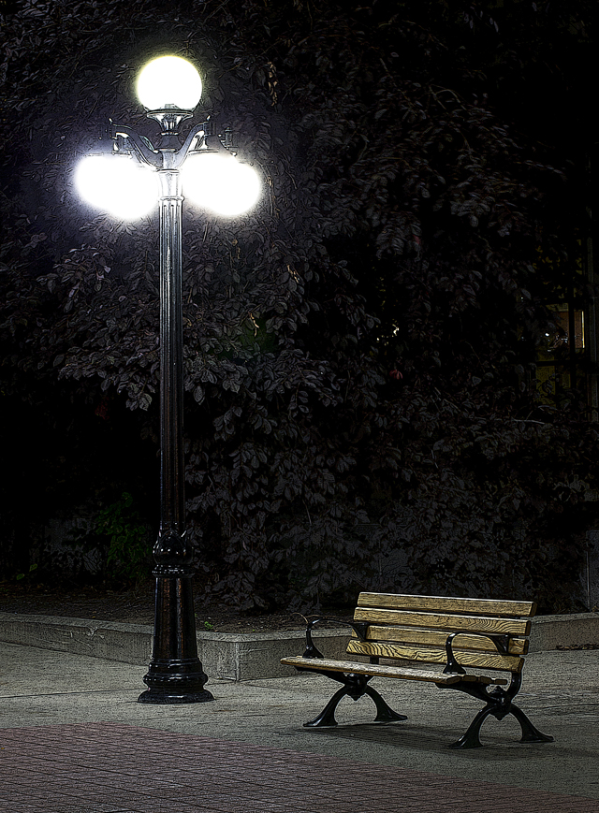
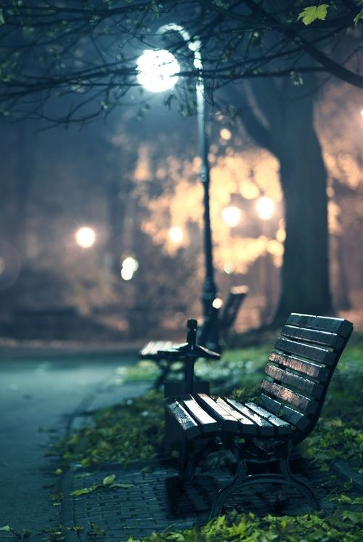
Final Moment, Outside

Slide 7
Research Images
Lighting

Slide 8
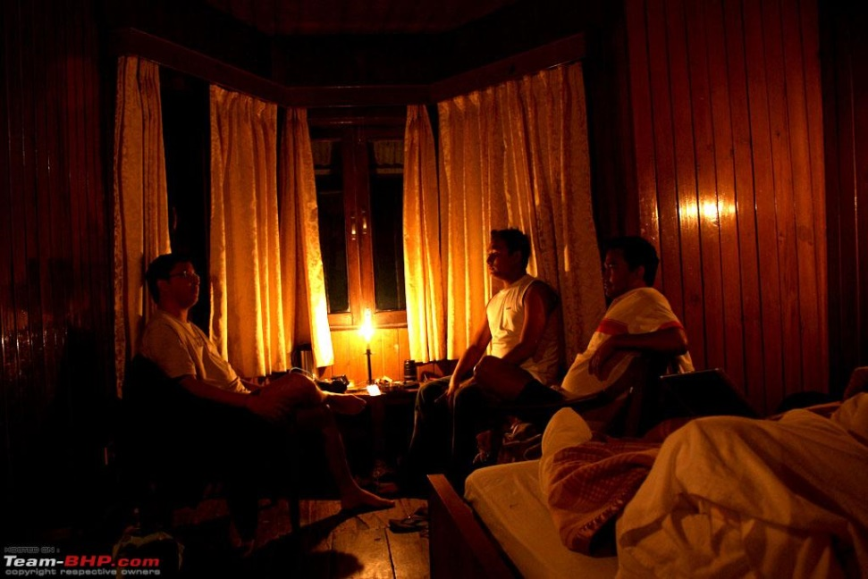
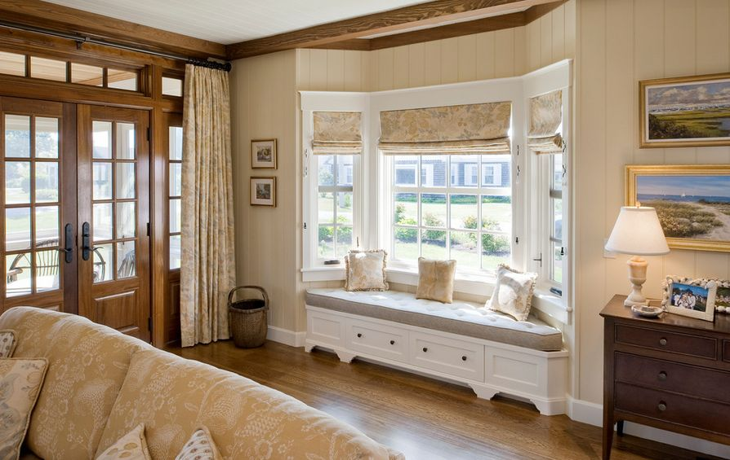
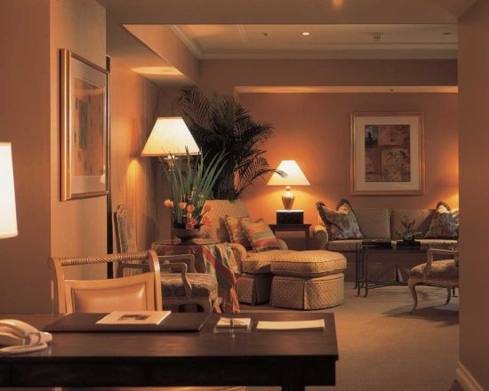
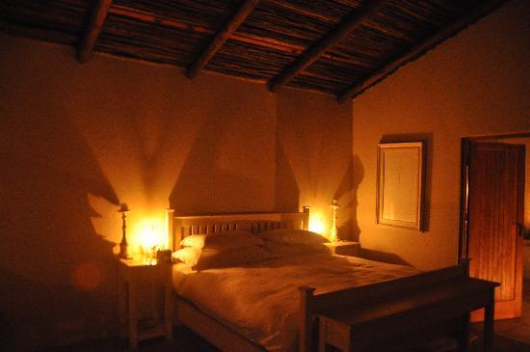
Living Room

Slide 10
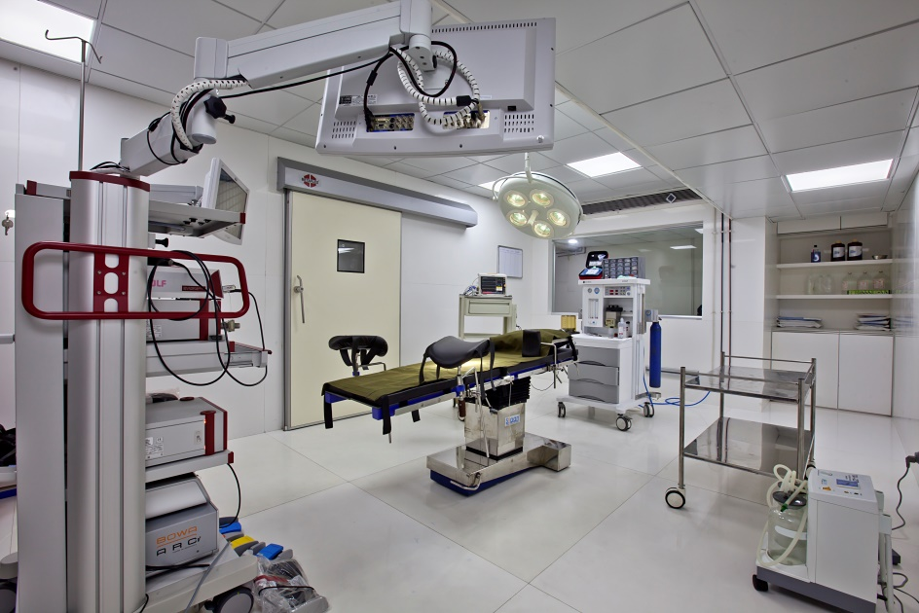
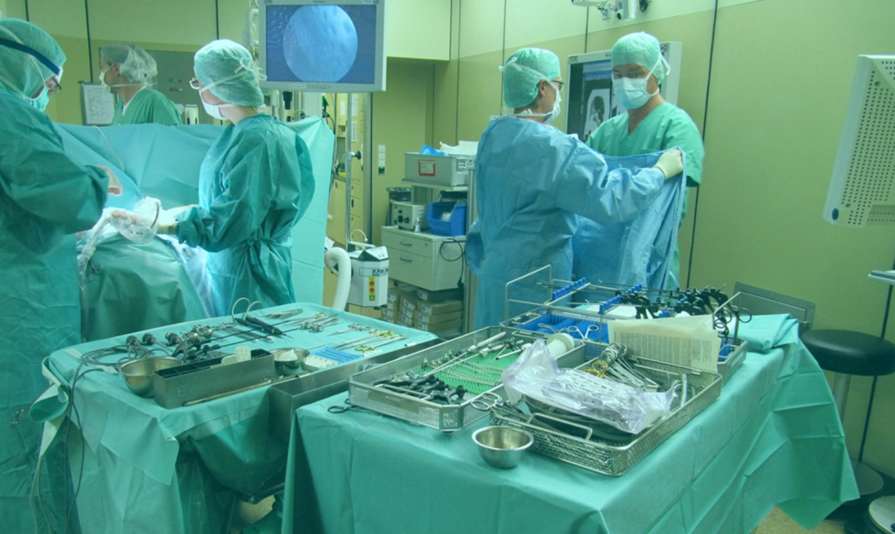
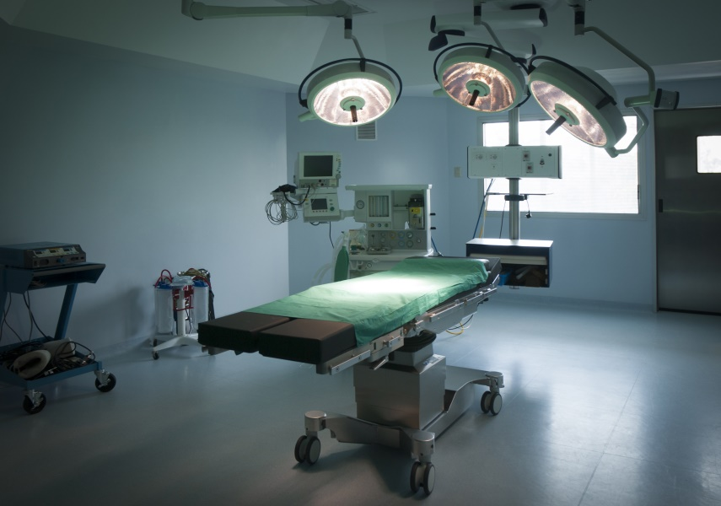
Operating Theatre

Slide 12
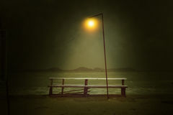
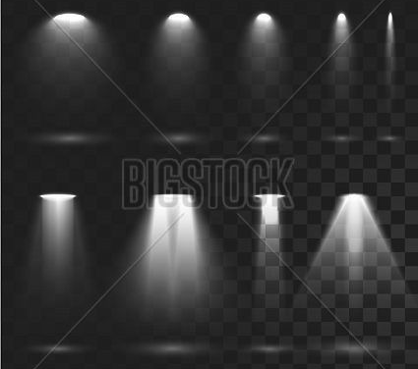
Final Moment, Outside

